Slide 1
Scaled Agile Survey
Basic Exploratory Data Analysis
DANA8411 · What the Survey Data Tells Us
60
63
9
Survey
Respondents
Survey
Questions
Practice
Sections

Slide 2
About the Survey
Understanding what was measured and how it is organised
IMPORTANCE
IMPLEMENTATION
SUCCESS
How important is each practice?
How well is each practice implemented?
How successful is the organisation?
Q6 — Portfolio Level
Q9 — Portfolio Level
Q12 — Enterprise Outcomes
Q7 — ART Level
Q10 — ART Level
Q13 — Programme Outcomes
Q8 — Team Level
Q11 — Team Level
Q14 — Customer Outcomes
All questions use a 1–5 scale (1 = Strongly Disagree / Not at All Important → 5 = Strongly Agree / Extremely Important)
DANA8411 | Scaled Agile Survey EDA | Basic Findings

Slide 3
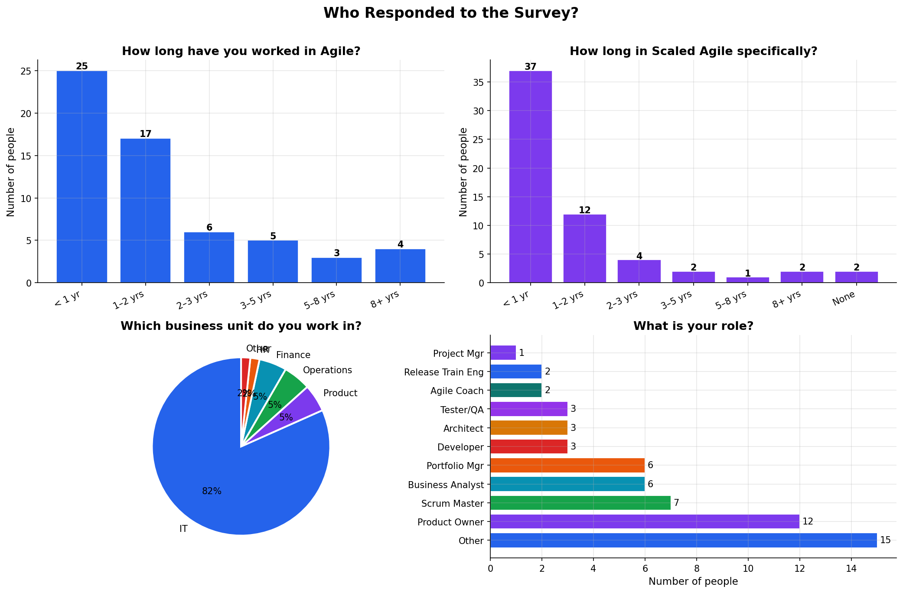
Who Responded?
Breakdown of the 60 survey participants by role, experience, organisation size, and industry
DANA8411 | Scaled Agile Survey EDA | Basic Findings

Slide 4
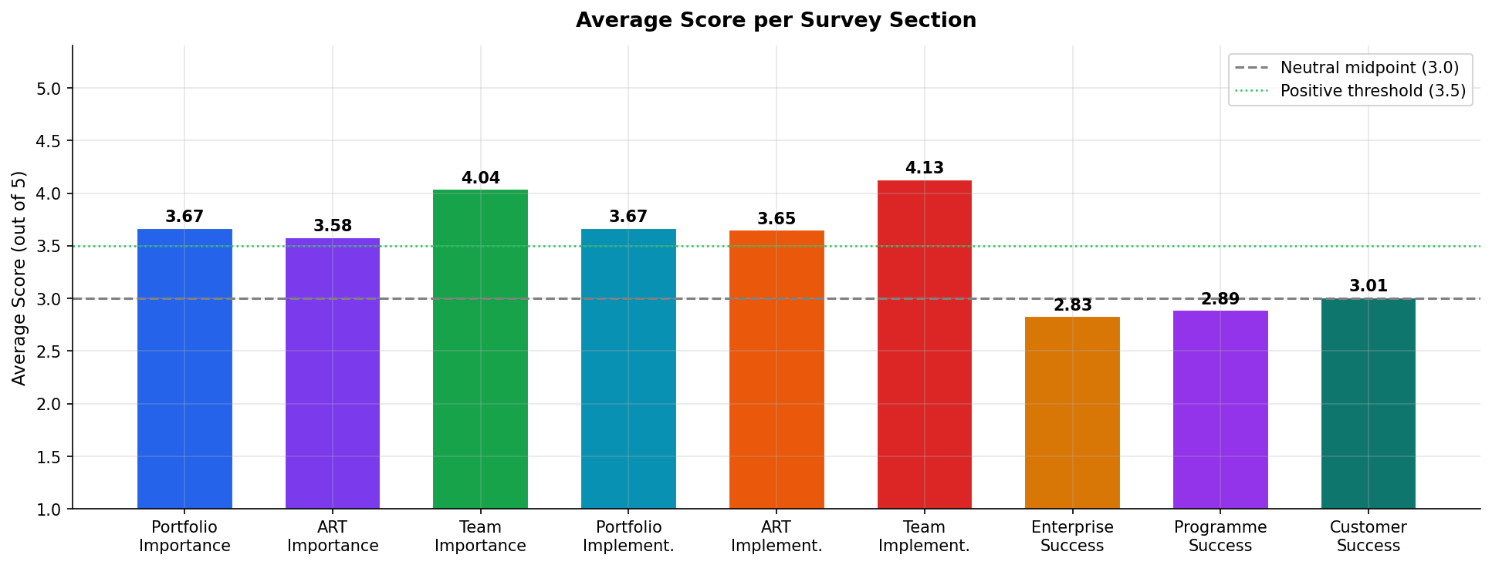
Average Scores Across All Sections
Mean rating (1–5) for each of the 9 practice areas — the dotted line marks the overall average
Importance scores (Q6–Q8) sit higher than Implementation scores (Q9–Q11) across all three levels — pointing to a consistent gap between intent and practice.
DANA8411 | Scaled Agile Survey EDA | Basic Findings

Slide 5
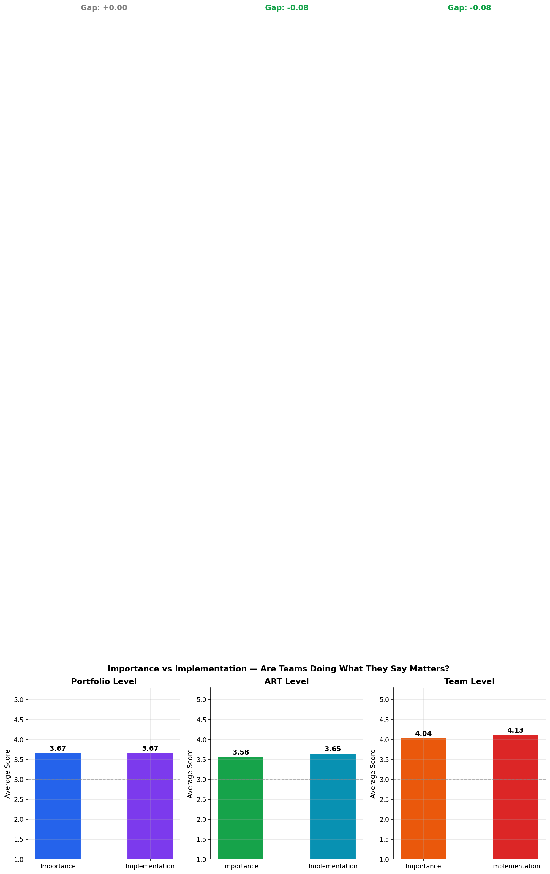
Importance vs Implementation Gap
Side-by-side comparison at each organisational level — how do intention and reality compare?
The gap is largest at Portfolio level — strategy and governance are seen as important but are least consistently implemented.
DANA8411 | Scaled Agile Survey EDA | Basic Findings

Slide 6
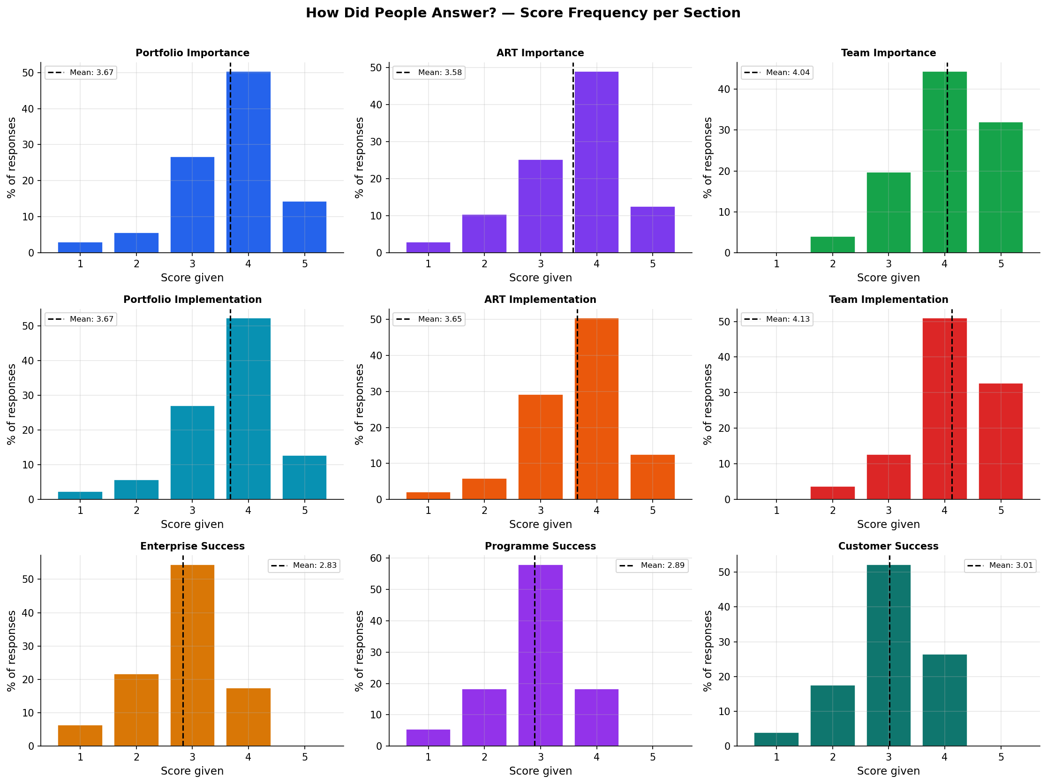
How Did People Score Each Section?
Count of responses at each rating (1–5) for every section — shows the spread of opinion
DANA8411 | Scaled Agile Survey EDA | Basic Findings

Slide 7
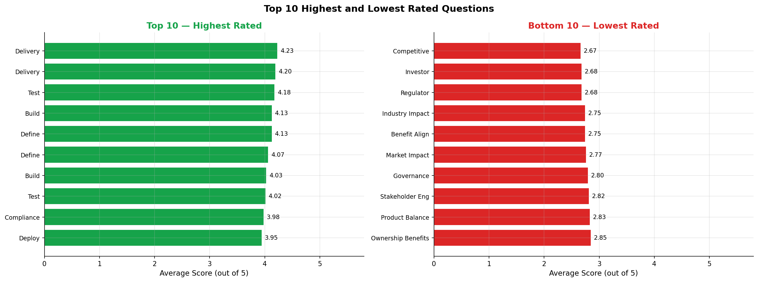
Highest & Lowest Rated Questions
The top 10 and bottom 10 individual questions by mean score across all 60 respondents
DANA8411 | Scaled Agile Survey EDA | Basic Findings

Slide 8
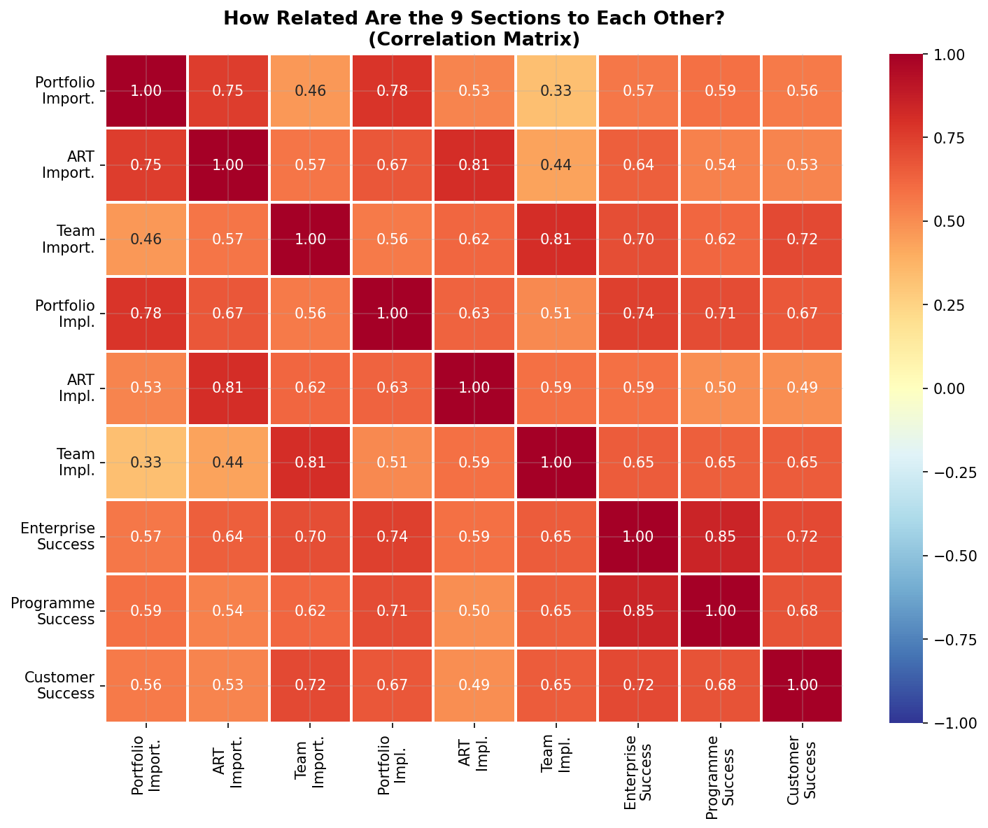
How Sections Relate to Each Other
Correlation heatmap — darker colour means the two sections tend to move together across respondents
A high correlation between two sections means: organisations that score well on one tend to score well on the other too.
DANA8411 | Scaled Agile Survey EDA | Basic Findings

Slide 9
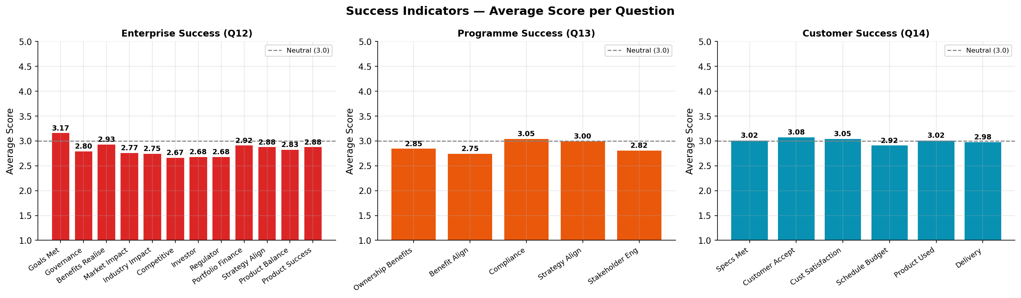
Success Outcome Scores
How respondents rated enterprise-level, programme-level, and customer-facing success outcomes
Programme-level success (Q13) scores are notably lower — suggesting organisations struggle more at the coordination layer than at team or enterprise levels.
DANA8411 | Scaled Agile Survey EDA | Basic Findings

Slide 10
Key Findings
Four plain-English takeaways from the basic exploratory analysis
Finding 1
Finding 2
Importance is rated higher than implementation
The gap is biggest at Portfolio level
Across all three organisational levels (Portfolio, ART, Team), respondents believe the practices are important — but say they are not consistently put into practice.
Strategy and governance practices (Q6 & Q9) show the widest gap between importance and implementation, suggesting senior-level adoption lags behind team-level work.
Finding 3
Finding 4
Most respondents agree — but there is spread
Programme-level success is the weak link
The frequency charts show ratings cluster around 3–4, meaning most respondents lean positive, but there is meaningful disagreement on how well practices are adopted.
Success outcome scores (Q12–Q14) are lowest for programme coordination (Q13), pointing to difficulties aligning multiple teams within an Agile Release Train.
DANA8411 | Scaled Agile Survey EDA | Basic Findings

Slide 11
Conclusion
The survey evidence shows a clear and consistent story:
organisations understand what good Scaled Agile looks like
but are still working to make it a consistent reality.
↑ Importance scores are above neutral (>3.5) for all nine sections
↓ Implementation scores trail behind at every level
⚠ Portfolio-level practices have the widest gap between intent and action
✓ Team-level practices are the most consistently implemented
DANA8411 · Scaled Agile Survey · Basic EDA

